Slide 1
MALIGNANT COMMENTS CLASSIFICATION
SUBMITTED BY
SACHIN GUPTA

Slide 2


Slide 3
INTRODUCTION
The conversational of social media is an issue that can lead people both to stop genuinely expressing themselves and to stop seeking others opinions out of fear of abuse and harassment. However, at the same time, this has resulted in the emergence of conflict and hate, making online environments uninviting for users.
There has been a remarkable increase in the cases of cyberbullying and trolls on various social media platforms
The goal of this project will be use to identify comments in text, which could be used to help deter users from posting potentially hurtful messages, craft more civil arguments when engaging in discourse with others, and to gauge the other users comments.
There has been a remarkable increase in the cases of cyberbullying and trolls on various social media platforms.
Online hate, described as abusive language, aggression, cyberbullying, hatefulness and many others has been identified as a major threat on online social media platforms.
Our goal is to build a prototype of online hate and abuse comment classifier which can used to classify hate and offensive comments so that it can be controlled and restricted from spreading hatred and cyberbullying.

Slide 4
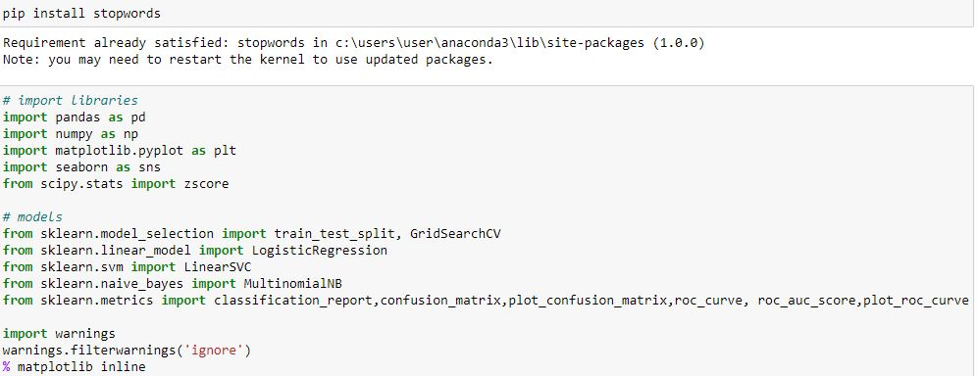
Libraries

Slide 5
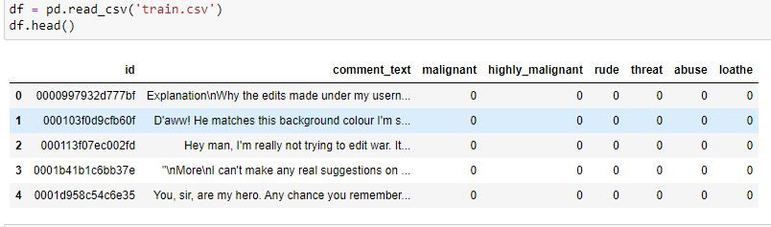
Loading the Dataset

Slide 6

Shape of the Dataset

Slide 7
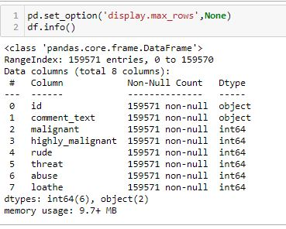
EDA – Exploratory Data Analysis
Checking columns count

Slide 8

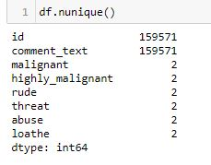
CHECKING CONTINOUS & CATEGORICAL COLUMNS

Slide 9
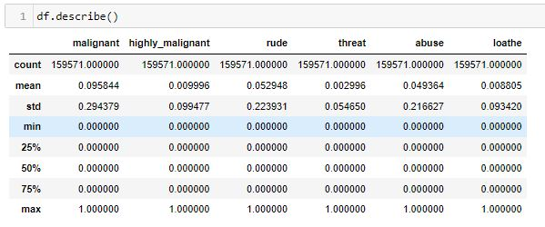
DESCRIBE THE DATASET

Slide 10
Data Visualizations
Donut charts
A donut chart is almost identical to a pie chart, but the center is cut out (hence the name 'donut').
Donut charts are also used to show proportions of categories that make up the whole, but the center can also be used to display data.
Pie charts
Pie charts can be used to show percentages of a whole, and represents percentages at a set point in time.
Count Plot
Count Plot is used to Show the counts of observations in each categorical bin using bars.¶
To create a horizontal bar chart or countplot in Seaborn,
you simply map your categorical variable to the y-axis (instead of the x-axis).
When you map the categorical variable to the y-axis, Seaborn will automatically create a horizontal countplot.

Slide 11
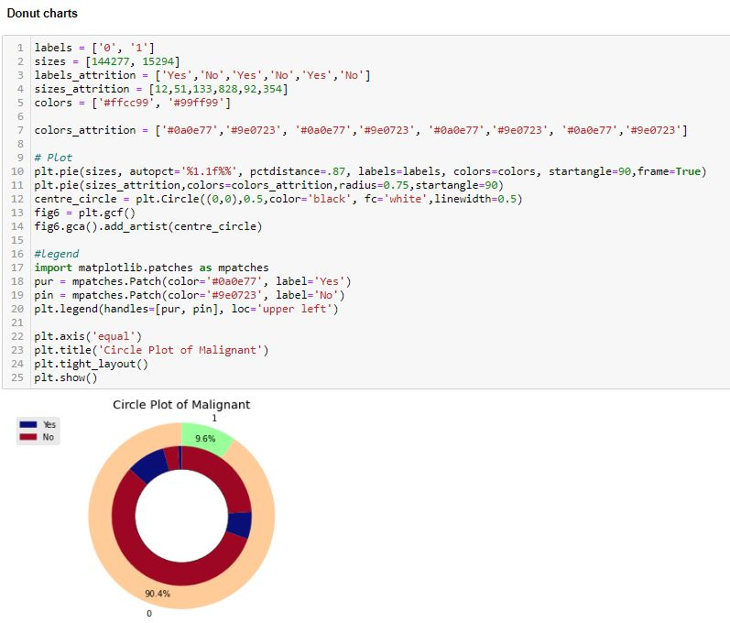
Malignant

Slide 12
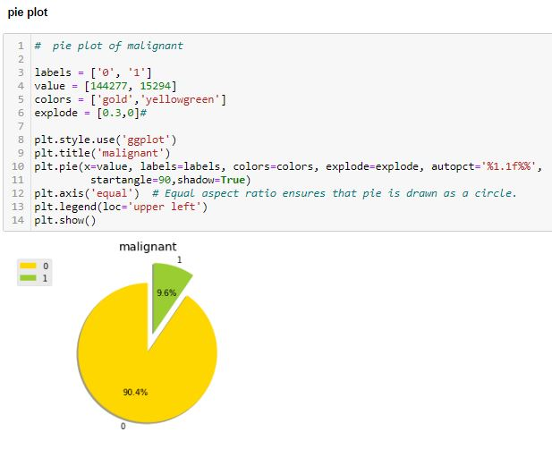
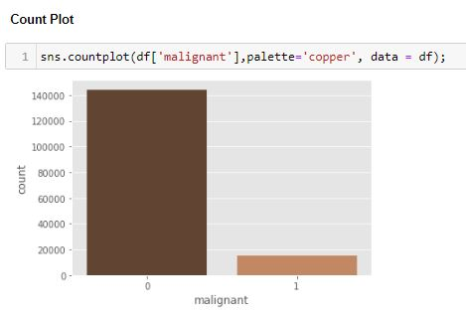

Slide 13
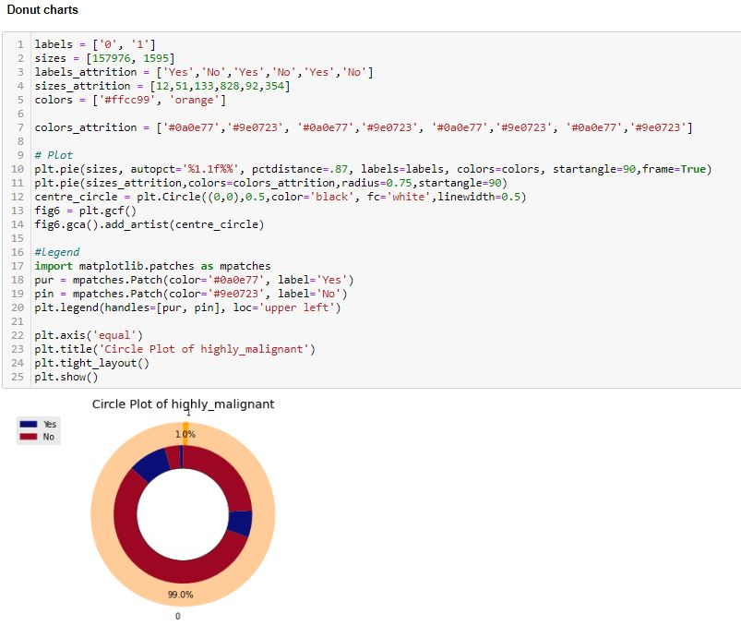
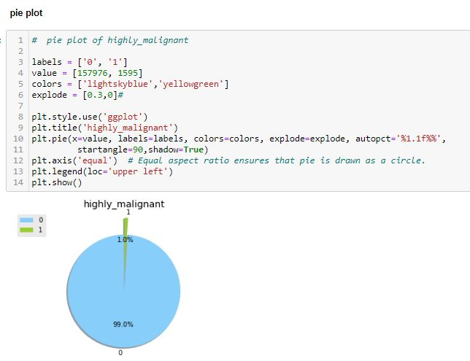
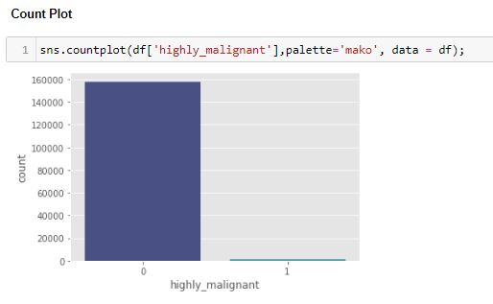
Highly_malignant

Slide 14
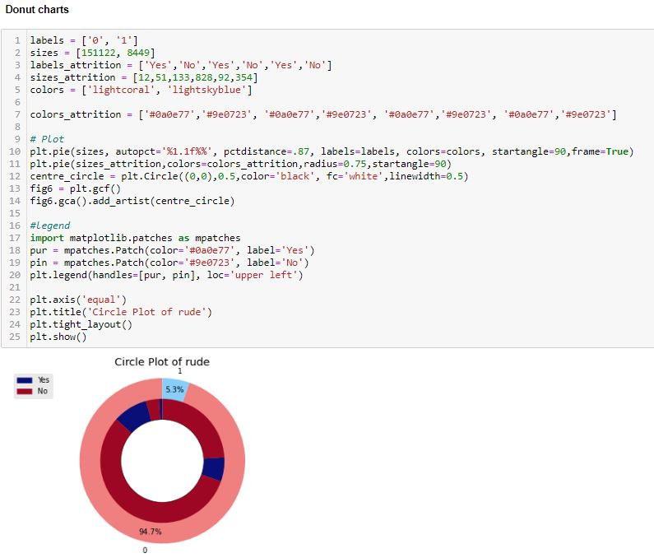
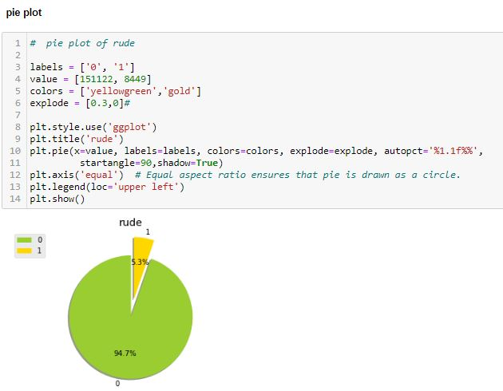
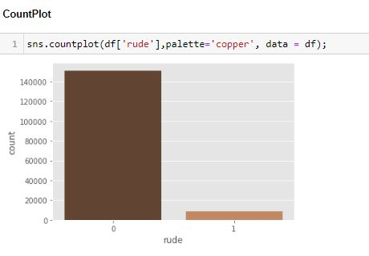
rude

Slide 15
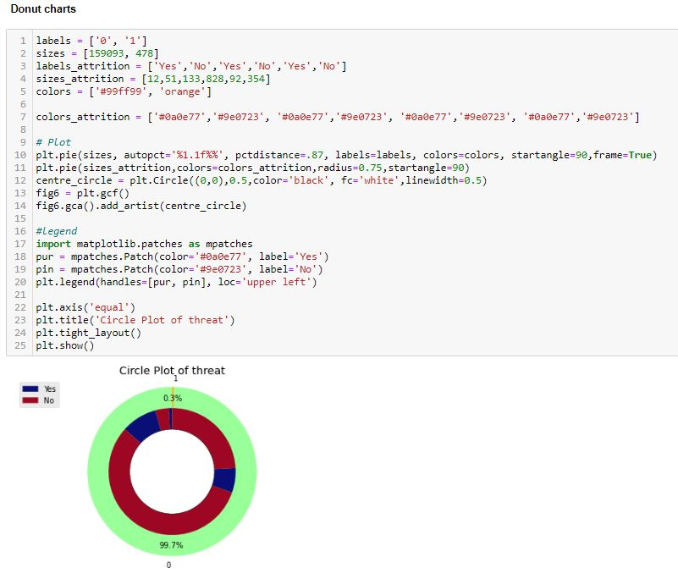
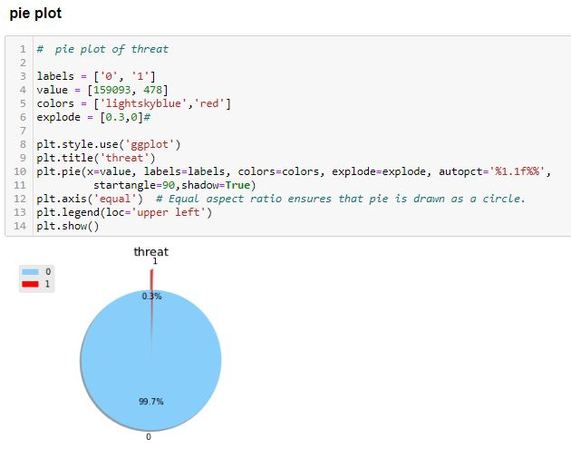
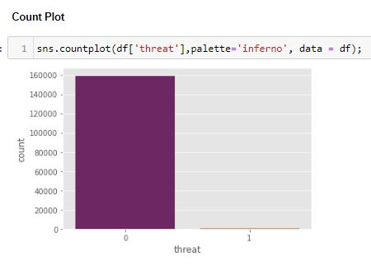
threat

Slide 16
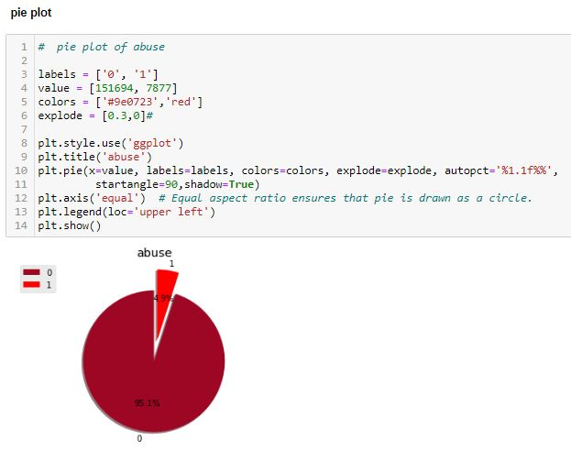
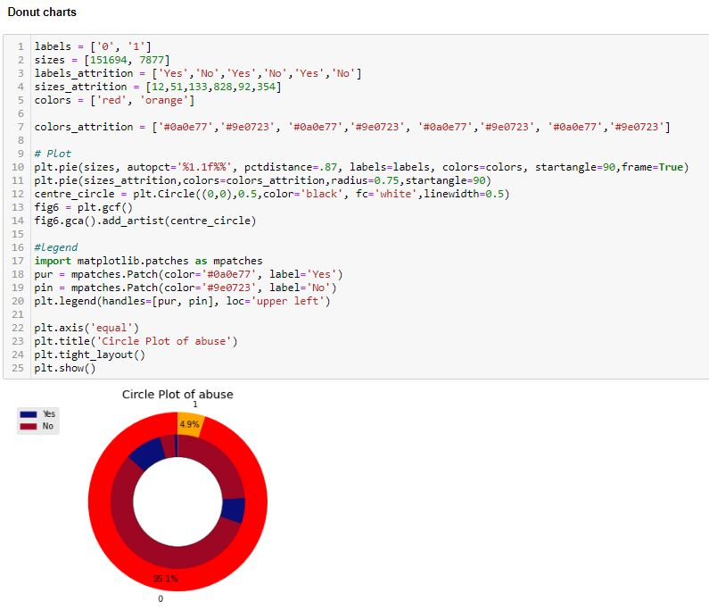
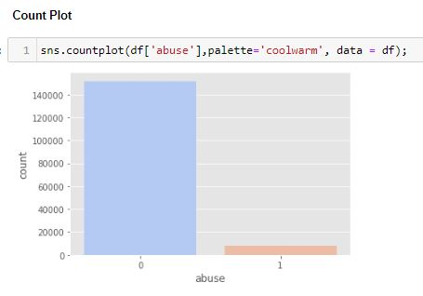
abuse

Slide 17
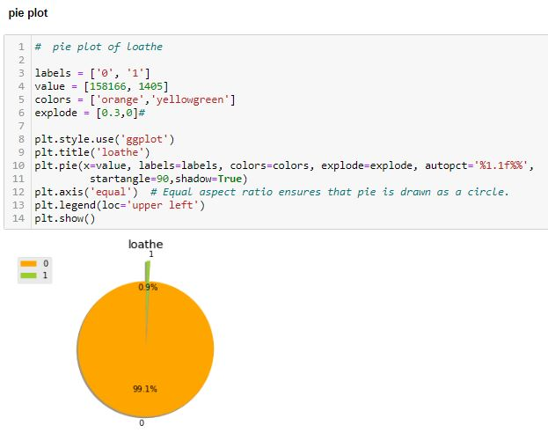
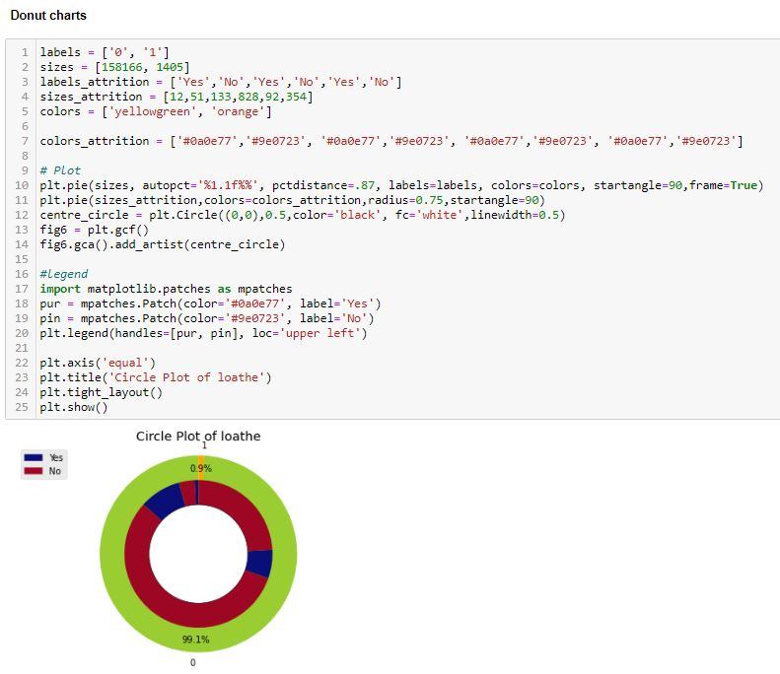
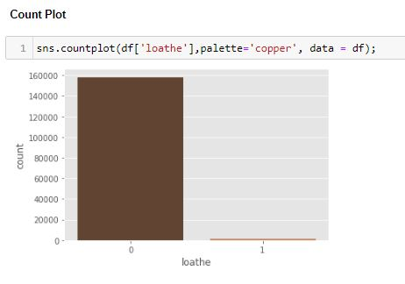
loathe

Slide 18
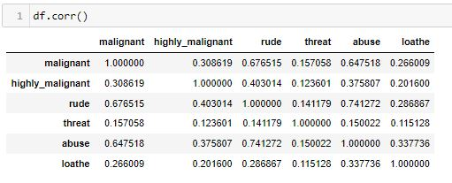
Correlation

Slide 19
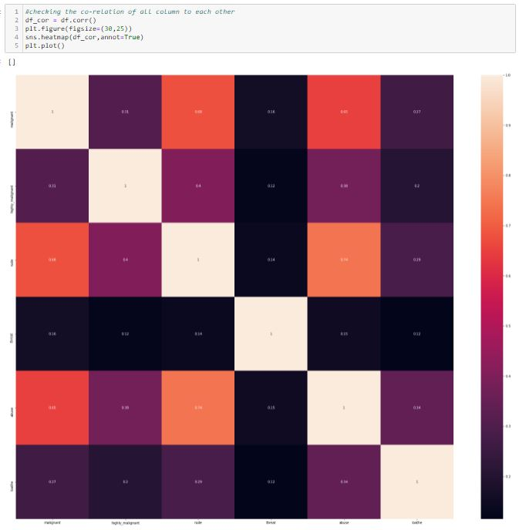
HeatMap

Slide 20
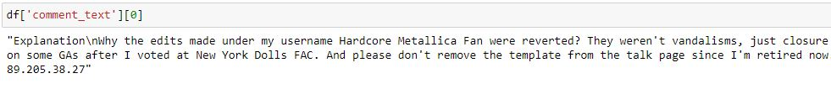
COMMENTS

Slide 21

nltk

Slide 22
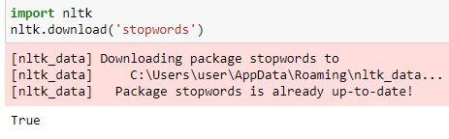
STOPWARDS

Slide 23
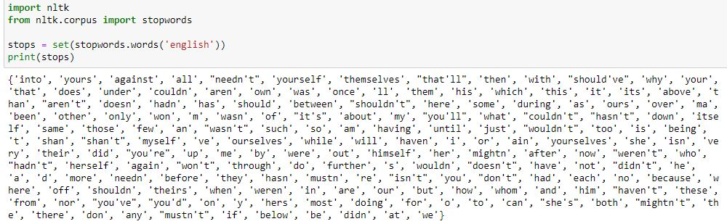
PRINTING ALL THE STOPWARDS

Slide 24

IMPORTING WORD NET LEMMATIZER

Slide 25
IMPORTING PORTER STEMER

Slide 26

Importing Regular expressions

Slide 27
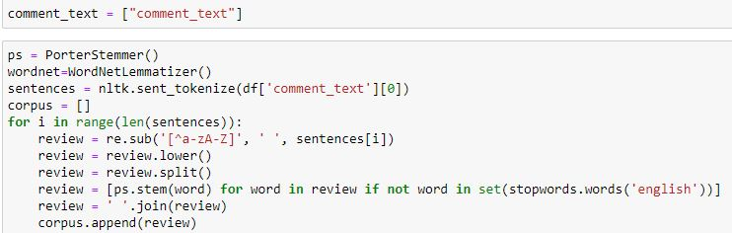
Using poster stemmer & word net lemmatizer

Slide 28

Count vectorizer

Slide 29
Listing all the labels

Slide 30
Model Building Train test split

Slide 31

Checking the shape

Slide 32
Machine Learning

Slide 33

Splitting the Data

Slide 34
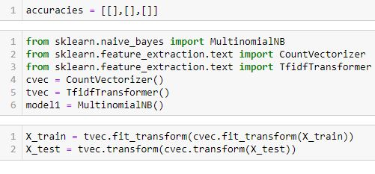
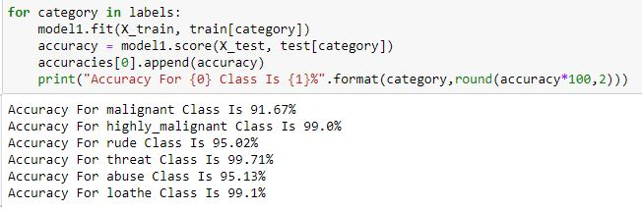
Multinomial Naive Bayes

Slide 35

Linear Support Vector Classifier

Slide 36
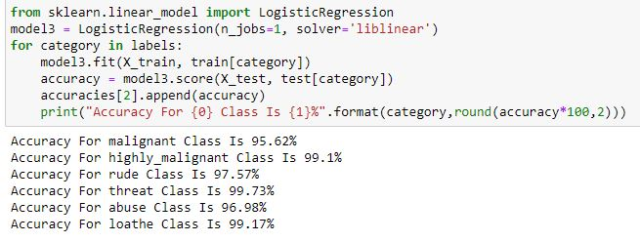
Logistic Regression

Slide 37
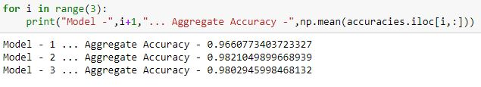
Aggregate accuracy

Slide 38
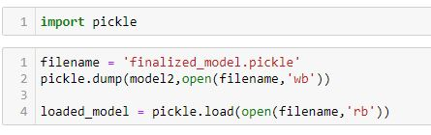
Saving the Best Model

Slide 39
Interpretation of the Results
I have used visualization tool such as count Plot to understand the data in a better way.
I used describe method for five-point summary analysis and also found the number of rows and columns in dataset.
I have done the model building with 3 algorithms and the best model is Linear Support Vector Classifier with an accuracy score of 98.21%

Slide 40
CONCLUSIONS
I have managed out how to prepare a model that gives users for a novel best approach at future lodging value predictions.
I have train dataset from which I had to extract information.
I had used pandas library to read the Dataset which provide me to explore & visualize the Data properly based on Rows & Columns.
I did exploratory data analysis on main data frame and tried to see all visualizations.
Based on visualization knowledge, I use various EDA TECHNIQUES to plot the count plot.
After from all these I split the Features & Labels into 2 parts.
On this data, I have applied our machine learning classification models such as Logistic regression, Linear Support Vector Classifier and Multinomial Naive Bayes train dataset.
After which I found Linear Support Vector Classifier has the High accuracy score(98.21%) and best among all the regressor models.

